Slide 1



Corporate Presentation
February 2024

Slide 2










Titularizadora Colombiana
Our Company
Created in 2001, after the Colombian 1990’s mortgage crisis
First asset securitization company in Colombia
Equity: USD $36 millions
Supervised by the Financial Superintendence of Colombia
More than USD $6,70bn in 74 issuances
Our Purpose
Connecting the financing needs of different economic activities with the capital market, with transparency, efficiency and under the principles of sustainability, through the securitization of assets.
Acknowledgments
Counterparty risk: AAA rating. This confirms our position as a market leader in mortgage securitization and administration
Best practices on information disclosure and investor relations Certification by the Colombian Stock Exchange Market– BVC since 2013.
ISO 9001:2008 IR Issuer Distinction
Management System quality certification as Master Servicing which involves the oversight of portfolio and information disclosure
Principles of Responsible Investment (PRI): Titularizadora Colombiana has been a signatory to PRI since December 2023.

Slide 3











Our History
SecuritizationMeaning
Securitization is the process of transforming illiquid assets into investable securities backed by the underlying assets’ cash flows.
2017
Orders of Payments Securitization
2001
Titularizadora Colombiana’s establishment
End of Colombia’s 1990’s mortgage crisis
2014
First goverment agency Securitization
2016
First non-banking mortgage securitization
2020
Real Estate Securitization 2nd tranche
2022
First ESG Securitization
2019
First automobile securitization
2004
First TECH issuance
2009
Titularizadora Peruana’s Establishment
2002
First TIPS issuance
2006
Acknowledgment:
Best non-banking Entity in LatAm
2010
End of tributary exemptions
USD$2,3bn issuance
2015
Non-mortgage securitization: Orders of Payments
2016
Commercial portfolio Securitization
2018
Real Estate Securitization 1st tranche
2020
Security issuance in Dominican Republic
2023
First automobile securitization

Slide 4





Securitization Scheme
Titularizadora Colombiana
Structuring
Issuance
Master servicing
Special Purpose Vehicle (SPV)
Credits/Real Estate (Assets)
Securities (Liabilities)
Originators
Investors
Origination
Portfolio servicing
Institutional Investors
Credit Institutions
General public
Mutual funds
Others
Warranty
  Internal
  External
  Credit Enhacement

Slide 5

SPV’s Legal Structure
Allows the creation of an SPV (Universality) that packages assets, their guarantees and rights and has legal, financial and accounting separation from the Originator of the underlying asset and Titularizadora Colombiana
Considering that the SPV does not have its own legal personality, the issuer is Titularizadora Colombiana charged to the SPV.
Special Legal Framework
Firm Sale
Remote bankruptcy
Property Separation
Assets are transferred and cannot be returned to the Originator. The cash flows belong to the SPV and are dedicated to the payment of the securities issued.
SPV
(Special Purpose Vehicule)
The SPV separates the assets from the Originator’s and Issuer’s equity financially, legally and on the books
The Assets are immune from bankruptcy of the Originator and the Securitizer (Titularizadora Colombiana)

Slide 6
SPV Financial Structure
Special Purpose
Vehicule*
Asset
Liabilities
Titles A have priority in payment and all coverage is made so that these titles are paid without any problem
Mortgage or
other type of
loans
Tranche A
A Special Purpose Vehicle (SPV) is a distinct company with its own assets and liabilities, as well as its own legal status. The SPV allows the investors to receive payments (A bond returns) from these underlying assts before any other creditors
TIPS A2038
Tranche B
The originator
generally suscribes subordinated securities
Tranche MZ
Tranche C
Profit that the originator earns when the portfolio performs well
Residual
*Only for loan asset-backed securities

Slide 7


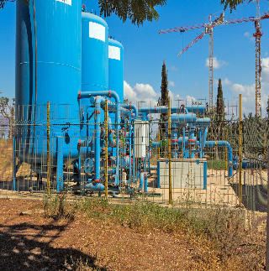
















Issuances by underlying asset and Originators
Mortgage
Commercial
Issuance | Type | # | Amount
TIPS PESOS | RMBS Fixed Rate OB | 37 | $ 4.064,37
TIPS UVR | RMBS Indexed OB | 19 | $ 1.908,73
TIS | RMBS Fixed Rate ONB | 2 | $ 23,93
TECH | RMBS Non-performing loans OB | 3 | $ 296,05
Total |  | 61 | $ 6.293,07
Issuance | Type | # | Amount
TER IPC | ABS Commercial Portfolio | 1 | $ 59,69
Real Estate
Issuance | Type | # | Amount
TIN | Real-Estate Assets | 2 | $ 68,33
Payroll Deduction Loans
Issuance | Type | # | Amount
TIL PESOS | ABS Order of Payment ONB | 4 | $ 83,73
Historic Issuance | # | Amount
 | 74 | $ 6.638,67
Automobiles
Issuance | Type | # | Amount
TIV PESOS | ABS Car Loans ONB | 4 | $ 133,74
Source: Titularizadora Colombiana. *Parity COP/USD= $3.918,31

Slide 8
Our Portfolio
Our total asset under management outstanding rose to USD $0.7 billions and involves different kinds of assets.
Asset-Backed Securities Outstanding
(USD billion)
Issuance by Year
(USD million)
Portfolio Structure
(USD billion)
Source: Titularizadora Colombiana. *Parity COP/USD= $3.918,31

Slide 9



Our Duties
Main Duties
Structuring
Placement
Management
Standard certification and formulation.
Definition of selection criteria.
Financial structure
Operational structure
Legal structure
Portfolio acquisition.
Asset Management
Liability Management
Investor Relations
Market Issuance Reports
Development of the Securities Market - Secondary Market
Commercial Management.
Investor Visits.
Coupon Rate Definition.
Allocation.

Slide 10
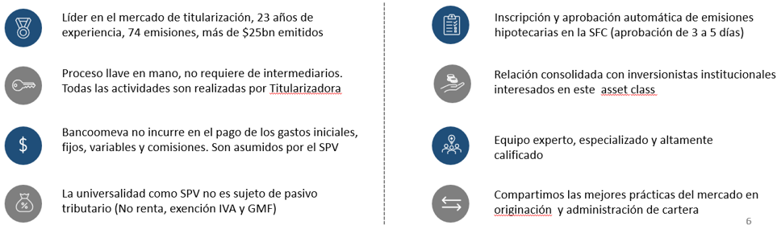

Our Main Strenghts
Leader in the securitization market, with 23 years of experience, 74 issuances, and over $6.70 billion issued.
Turnkey process: No intermediaries required. All activities are carried out by Titularizadora Colombiana.
Originator’s cost coverage: The originator does not incur initial, fixed, variable, or commission expenses. These costs are borne by the SPV.
The SPV is not subject to tax liability (no income tax, VAT exemption, and Financial Transactions Tax).
Automatic registration and approval of mortgage issuances with the SFC (approval within 3 to 5 days).
Consolidated relationship with institutional investors interested in this asset class.
Expert, specialized, and highly qualified team.
We share best market practices in portfolio origination and management.
El originador

Slide 11
Our Contribution
Our products contributed to the development of fixed-rate loans and lower costs in the housing finance sector.
Average Mortgage Interest Rate
(%)
Source: Superintendencia Financiera de Colombia and Banco de la República *Value Year to date

Slide 12
Our Contribution
Our products contributed to the development of fixed-rate loans and lower costs in the housing finance sector.
Mortgage Loans Outstanding
(USD$ billions)
Non-perfoming Loans (>4 months)
(USD$ billions)
Source: Titularizadora Colombiana. *Parity COP/USD= $3.918,31

Slide 13
Our Contribution
Also promoting the development of the Colombian capital market.
Share of Fixed Rate Issuance
(USD million)
Source: Titularizadora Colombiana. *Parity COP/USD= $ 3.918,31

Slide 14
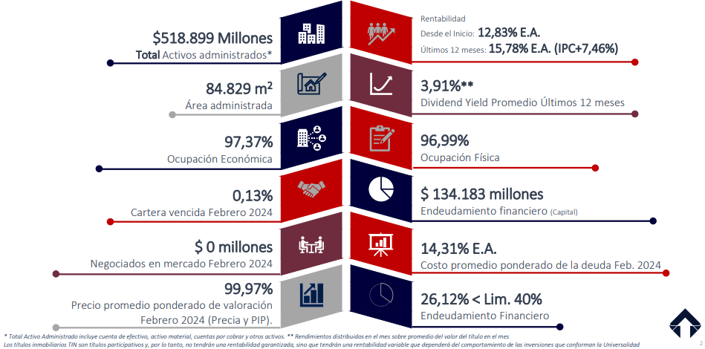





Indicators of our real-estate vehicle TIN
Profitability
All time:
Last 12 months:

Slide 15



Strategic Pillars | Strategic Plan Titularizadora 2022-2027
1
Enhancing the mortgage portfolio business
(Core business)
Success example in the market
Reviewing / adjusting current value proposition
Further developing the client´s vision (originator and investor)
2
3
Developing businesses with significant rates of economic growth and competitive advantages in the market
(Adjacent businesses)
Non-mortgage loan portfolios of banks and non-banks institutions
Real Estate business
Innovative, eficient and resilient
Exploring and incorporating new technologies and disruptive models
(Bets)
Disruptive / digital ecosystem
Securitization of other assets
Data mining
Together we achive more
More clients, more development
Better growth and major competitive advantages in the market
Sustainable and responsible business models

Slide 16

Strategic Pillars | Strategic Plan Titularizadora 2022-2027
4
Environmental Strategy
Garbage Campaign
Better Use of Paper
Campaign
Disposable items campaign
Energy Saving
Campaign
Water Saving
Campaign
Internal Disclosure
Strengthening the internal campaign “Think Green: Leave your mark in the planet”

Slide 17








Our Social Securitization
Date
December 16th 2022
Impact:
Originator
Series A Rating
AAA
Second opinion
“Good”
10%
Ensure that the poor and the most vulnerable have equal rights in terms of economic resources, as well as access to basic services.
Strengthen the capacity of national financial institutions to promote and expand access to financial services.
Empower and promote social, economic, and political inclusion, regardless of age, gender, disability, race, ethnicity, or economic situation or any other condition.
Ensure access to adequate, safe, and affordable housing and improve low-income neighborhoods.
Portfolio Type
Mortgage VIS (100%)
18%
Issued Amount
123.053.000 UVR* (39.769 billon COP)
Series A placement rate
7,80% E.A (UVR*)
Number of underlying assets
1.012 Mortgages
*The unit of real value (UVR in Spanish) is a unit of account that reflects the purchasing power of the currency based on the variation of the consumer price index (CPI).
Source: Bolsa de Valores de Colombia.

Slide 18












Our Sustainability Strategy
Stakeholders
Ethics, Integrity, and Anti-Corruption
Fair and equitable
Equity, diversity and inclussion
Corporate governance and proper management of all risks
Staff
Shareholders
Board of Directors
Investors
Originators
Authorities
Placement agents
Supliers
Credit rating agencies
Tenants
Transparency and Disclosure
Transforming assets for a sustainable future.
Human Rights
Transforming assets for a sustainable future
Profitable Growth
Prosperous
Environmentally
Friendly
Sustainable Finances
Climate Change
Stakeholder Management
Responsible Investment
Integrates

Slide 19
Contact Information
Investment and Market Development Director
asalcedo@titularizadora.com
Phone: 6183030 Ext. 257
Investment Coordinator
smoreno@titularizadora.com
Phone. 6183030 Ext. 258
Investment Coordinator
josorio@titularizadora.com
Tel. 6183030

Slide 20
Titularizadora Colombiana
“Titularizadora Colombiana S.A. releases this document strictly for the investors'
information purposes. Although the data included here comes from sources
deemed as trustable by the company, Titularizadora Colombiana S.A. does not
guarantee their accuracy. In no case its content may be considered as a financial
or legal opinion nor as a business or investment recommendation by the
company. Neither may it be considered as an invitation to do business or as an
offer to buy or sell any kind of security. In any case, Titularizadora Colombiana
S.A. is not responsible for the investment decisions made, or the result of any
operation carried out by the addresses, or any third parties based on the
information contained in this document. Such responsibility falls exclusively on
the investors that use such information. Variations may happen after the release
of such information, therefore Titularizadora Colombiana S.A. reserves the right
to change or update them at any time and without notice.”

